Slide 1


“Information Security”
Lecture # 8
Dr. Engr. M Malook Rind
Ph.D (I.T), ME (CSN), MBA (MIS), BE (CS)
CCNA, CCNP, Juniper Certified.
Professor (Computer Science)

Slide 2

Contents
Identity and Access Management (IAM)
Dr. M Malook Rind Information Security Lecture 8

Slide 3
Identity and Access Management (IAM)
Exploring Authentication Management
Managing Accounts
Comparing Authentication Services
Comparing Access Control Schemes
Dr. M Malook Rind Information Security Lecture 8

Slide 4
Identity and Access Management (IAM)
Identity and Access Management (IAM) is a framework of policies, processes, and technologies that enable organizations to manage digital identities and control user access to critical corporate information
Identification Identity and access management (IAM) is focused on managing user identities and access permissions on a computer network.
IAM policies, processes, and technologies can differ between companies, the goal is to ensure that the right users and devices can access the right resources for the right reasons at the right time
The core objective of an IAM platform is to assign one digital identity to each individual or a device
Dr. M Malook Rind Information Security Lecture 8

Slide 5
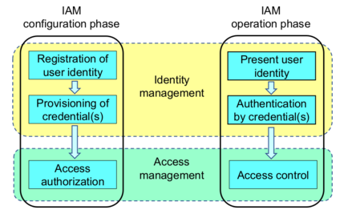
How Does IAM Work?
IAM confirms that the user, software, or hardware is who they say they are by authenticating their credentials against a database.
Identity access management systems grant only the appropriate level of access
Dr. M Malook Rind Information Security Lecture 8

Slide 6
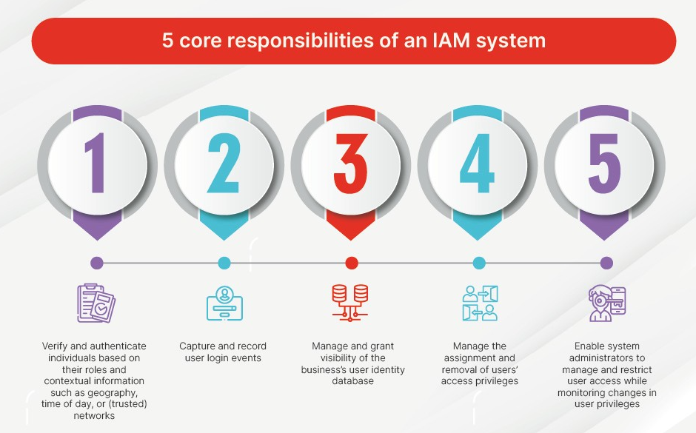
Identity and Access Management (IAM)
Dr. M Malook Rind Information Security Lecture 8

Slide 7
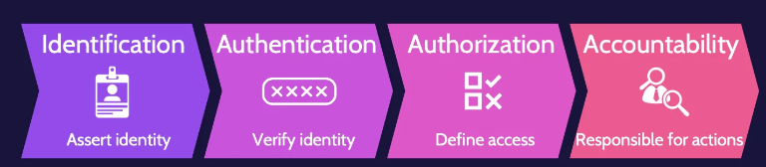
Identity and Access Management (IAM) Components
A comprehensive Access Management System consist of identification, authentication, authorization, and accountability.
Dr. M Malook Rind Information Security Lecture 8

Slide 8
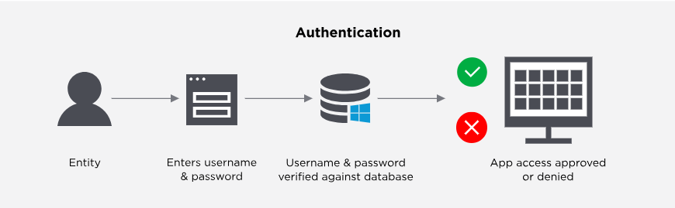
Identity and Access Management (IAM) Components
Identification
claiming an identity,
a user claims their identity with some sort of identifier whether it's in form of username or email addresses
Authentication
The process by which it can be identified that the user, which wants to access the network resources, valid or not by asking some credentials such as username and password.
User proves identity
Dr. M Malook Rind Information Security Lecture 8

Slide 9
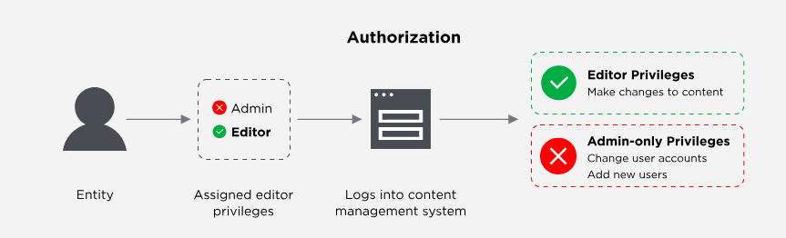
Identity and Access Management (IAM) Components
Authorization
Users are granted authorization to access resources based on their proven identity
Accounting
track user activity and record the activity in logs.
collect and log data on user sessions, such as length of time, type of session, and resource usage.
Dr. M Malook Rind Information Security Lecture 8

Slide 10
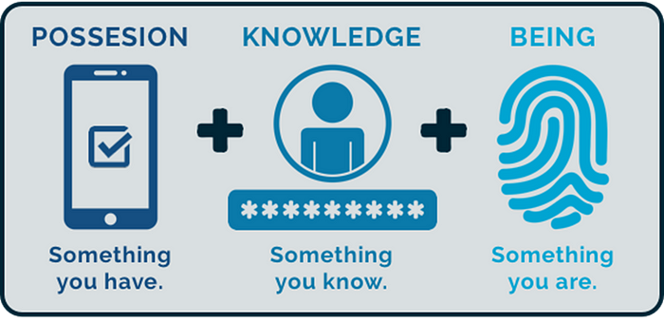
Factors/Types of Authentication
Factors/types of authentications can confirm an entity/person’s identity and thus give access to restricted areas or materials while also denying access by an imposter.
In IT context, these types of elements are known as authentication credentials
Basic Factors of Authentication include:
Something you know (Knowledge factors)
Such as username and password
Something you have (Possession factors)
Such as a smart card
Something you are (Inherence factors)
Such as a fingerprint or other biometric
identification
Dr. M Malook Rind Information Security Lecture 8

Slide 11
Factors/Types of Authentication
Other than these three Factors/Types of Authentication (something you know, something you have, and something you are) four other factors (called attributes) are also used:
Somewhere you are (Location factors)
Restricted location
Something you exhibit
Genetically determined characteristic
Someone you know
Validated by another person
Someone you can do (Behavior-Based)
Perform an activity that cannot be exactly copied
Note: Although many authentication credentials can be presented to an IT system to verify the genuineness of the user, all credentials can be classified into one of these seven categories.
Dr. M Malook Rind Information Security Lecture 8

Slide 12
Factors of Authentication - Something You Know (Password)
The something you know authentication factor typically refers to a shared secret, such as a password, a static code, or a PIN.
This factor is the least secure form of authentication.
Password complexity
making passwords more secure is to require them to be complex and strong.
current recommendations suggest a length of at least 8 characters
longer password isn’t necessarily stronger if it isn’t complex
Uppercase characters (26 letters A–Z)
Lowercase characters (26 letters a–z)
Numbers (10 numbers 0–9)
Special characters (such as !, $, and *)
Password expiration
password expiration setting identifies when users must change their password
the maximum password age should be 60 days.
Dr. M Malook Rind Information Security Lecture 8

Slide 13
Factors of Authentication - Something You Know (Password)
Password vaults
A password vault (or password manager) is a single source designed to keep most of your passwords.
Instead of requiring you to memorize many different passwords, you only need to remember the password to open the vault.
It keeps these passwords in an encrypted format, preventing unauthorized users from seeing them
Google Chrome includes a password manager built into the browser.
Password history and password reuse
Prevents users from reusing same password
Recommended to use password policy settings to remember the last 24 passwords and prevent users from reusing them until they’ve used 24 new passwords.
Changing Default Passwords
defaults should be changed before putting the application or device into service.
Changing defaults also includes changing the default name of the Administrator account, if possible.
Dr. M Malook Rind Information Security Lecture 8

Slide 14
Factors of Authentication - Something You Know (Password)
Knowledge-Based Authentication
typically used to verify your identity when you’ve forgotten your password.
After creating your account (or when you create your account), you’re prompted to answer questions about yourself, such as your first dog’s name or your mother’s maiden name.
Later, when you try to retrieve a forgotten password, you’re first prompted to answer the same questions.
Implementing Account Lockout Policies
preventing users from guessing the password.
If a user enters the wrong password too many times (such as three or five times), the system locks the user’s account.
Account lockout threshold: This is the maximum number of times a user can enter the wrong password.
Account lockout duration. This indicates how long an account remains locked.
Training Users About Password Behaviors
Organizations need to provide adequate training to users on password security if they use passwords within the organization
Including creating strong passwords, not using the same password with other systems, and never giving their password to someone else.
Dr. M Malook Rind Information Security Lecture 8

Slide 15
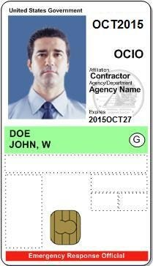

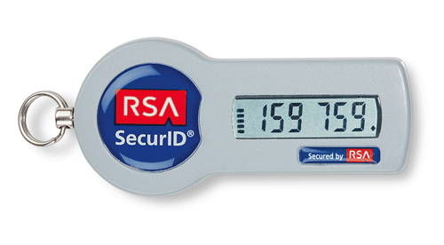
Factors of Authentication - Something you have (Possession factors)
The something you have authentication factor refers to something you can physically hold. Such as smart cards, Common Access Cards, and Hardware Tokens
Smart Card
Smart cards are credit card-sized cards that have an embedded microchip and a certificate.
The smart card reader reads the card’s information, including the details from the certificate, which provides certificate-based authentication
The smart card provides confidentiality, integrity, authentication, and non-repudiation
often used with another factor of authentication. a user may also enter a PIN or password and use the smart card (a dual-factor authentication)
Token Key
A token key is an electronic device about the size of a remote key for a car.
Number on the LCD changes periodically, every 60 seconds and is replaced by another one-time password.
The token is synced with a server that knows what the number is at any moment.
Dr. M Malook Rind Information Security Lecture 8

Slide 16
Factors of Authentication - Something you have (Possession factors)
HOTP (HMAC-based One-Time Password (HOTP))
Hash-based Message Authentication Code (HMAC) OTP is an open standard used for creating one-time passwords, a number created with a hashing algorithm (6 to 8 digit).
Similar to those used in tokens or key fobs (uses incrementing counter)
A password created with HOTP remains valid until it’s used
TOTP (Time-based One-Time Password)
Similar to HOTP, but it uses a timestamp instead of a counter.
One-time passwords created typically expire after 30 seconds, but the time is adjustable.
Two-Step Verification
also called two-factor authentication) adds an extra layer of security to accounts.
Users typically enter their username and password into a website using the something you know factor.
Then, they receive a message or notification on their phone something you have factor
Dr. M Malook Rind Information Security Lecture 8

Slide 17
Factors of Authentication - Something you are (Inherence factors)
The something you Are authentication factor uses biometrics for authentication.
Biometric methods are the strongest form of authentication because they are the most difficult for an attacker to falsify.
Biometrics Methods
Biometrics uses a physical characteristic, such as a fingerprint.
Most biometric systems use a two-step process. First users register or enroll (captures, associates - Identification), second to prove their identity (authentication)
fingerprint, thumbprint, or handprints
Retinal scanners (scans the retina of one or both eyes)
Iris scanners (scans the iris of one or both eyes)
Vein matching: Many systems and health care systems use palm scanners as a quick and easy way of identification
Voice recognition
Facial recognition
Gait analysis (identifies individuals based on the way they walk)
Dr. M Malook Rind Information Security Lecture 8

Slide 18
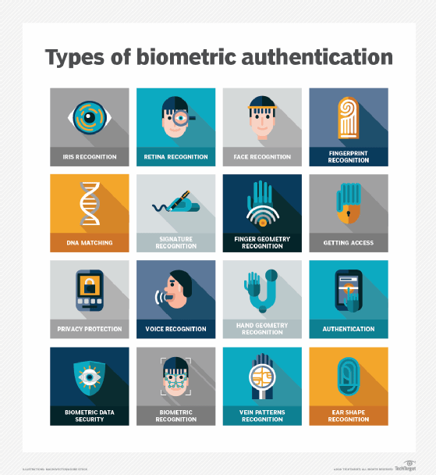
Factors of Authentication - Something you are (Inherence factors)
Dr. M Malook Rind Information Security Lecture 8

Slide 19
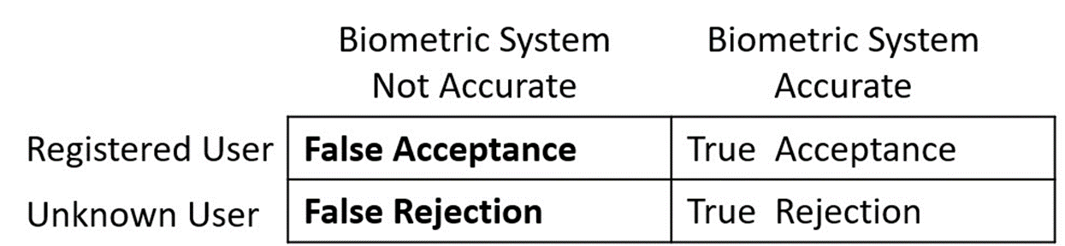
Factors of Authentication - Something you are (Inherence factors)
Biometric Efficacy Rates
The biometric efficacy rate refers to the performance of the system under ideal conditions.
If the system is implemented correctly, it can be very exact.
However, if it isn’t implemented correctly, its real-world effectiveness may not match the efficacy rate.
False acceptance. This is when a biometric system incorrectly identifies an unknown user as a registered user.
The false acceptance rate identifies the percentage of times false acceptance occurs.
False rejection. This is when a biometric system incorrectly rejects a registered user.
The false rejection rate (FRR, also known as a false non match rate) identifies the percentage of
times false rejections occur.
True acceptance. This indicates that the biometric system correctly identified a registered user.
True rejection. This indicates that the biometric system correctly rejected an unknown user.
Dr. M Malook Rind Information Security Lecture 8

Slide 20
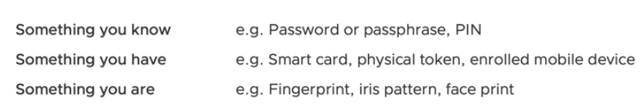
Factors of Authentication - Something you are (Inherence factors)
Two-Factor and Multifactor Authentication
Two-factor authentication (sometimes called dual-factor authentication) uses two different authentication factors such as something you have and something you know.
Two-factor authentication often uses combinations of:
a smart card and a PIN,
a USB token and a PIN, or
a hardware token and a password.
Using two methods of authentication in the same factor is not two-factor authentication
requiring users to enter a password and a reusable PIN (both in the something you know factor) is single-factor authentication, not dual-factor authentication
Similarly, using a thumbprint and a retina scan is not dual-factor authentication because both methods are in the
something you are factor.
Dr. M Malook Rind Information Security Lecture 8

Slide 21
Factors of Authentication - Authentication Attributes
Authentication attributes help identify a user or a device based on characteristics or traits.
These are rarely used on their own but instead are used with one or more authentication factors.
Somewhere You Are (Location factors)
The somewhere you are authentication attribute identifies a user’s location.
Geo-Fencing: Grants access only when the user is in a specific geographical area.
IP Address Verification: Allows access only from certain IP addresses, often used in corporate settings.
an IP address for geolocation isn’t foolproof. There are many virtual private network (VPN) IP address changers available online.
Something You Can Do (Behavior-Based)
The something you can do authentication factor refers to actions you can take such as gestures on a touch screen.
Keystroke Dynamics: Studies the unique way a user types on a keyboard.
Mouse Movement Patterns: Analyzes the way a user moves the mouse while interacting with a system.
Dr. M Malook Rind Information Security Lecture 8

Slide 22
Factors of Authentication - Authentication Attributes
Something You Exhibit
Generically, exhibit refers to something that you show or display.
Within the context of authentication attributes, a badge worn by an employee is something you can exhibit.
Common Access Cards (CACs) or Personal Identity Verification (PIV) cards include a picture of users along with personnel information, such as their name, and are worn as a badge when users are walking around the building.
Someone You Know
Validated by another person
A web of trust is an example
Dr. M Malook Rind Information Security Lecture 8

Slide 23
Factors of Authentication - Authentication Log Files
Authentication log files can track both successful and unsuccessful login attempts.
It’s most important to monitor login activity for any privileged accounts, such as administrators.
Entries from authentication logs can be sent to a SIEM system for analysis and notification of suspicious events.
Log entries help administrators determine what happened, when it happened, where it happened, and who or what did it. For authentication log entries:
What happened is either a login success or failure
When it happened is determined by the time and date stamps
Where it happened is typically an IP address or computer name
Who or what did it refers to the user account
Dr. M Malook Rind Information Security Lecture 8

Slide 24
Managing Accounts
Account management is concerned with the creation, management, disablement, and termination of accounts.
When the account is active, access control methods are used to control what the user can do.
Additionally, administrators use access controls to control when, where, and how users can log on.
Common account management practices include:
Credential Policies and Account Types
Credential policies define login policies for different personnel, devices, and accounts.
This includes items in the something you know factor (such as passwords) or any other factor or combination of factors.
It’s common for an organization to apply credential policies differently to different types of accounts.
Personnel or end-user accounts: creating these accounts and assigning appropriate privileges based on the user’s job responsibilities
Administrator and root accounts: are privileged accounts that have additional rights and privileges beyond a regular user has.
Service accounts: like a regular end-user account, but it’s used by the service or application, not an end user
Device accounts: Computers and other devices also have accounts, only allows users to log on to computers joined to the domain
Third-party accounts: are accounts from external entities that have access to a network.
Guest accounts: are useful if you want to grant someone limited access to a computer or network without creating a new account
Shared and generic: An organization can create a regular user account that temporary workers will share
Dr. M Malook Rind Information Security Lecture 8

Slide 25
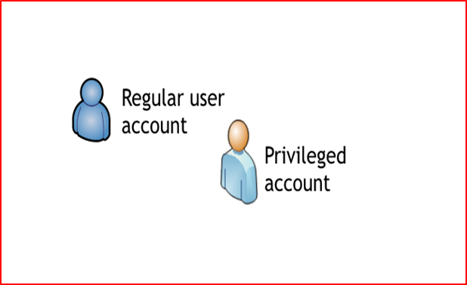
Managing Accounts
Privileged Access Management
allows an organization to apply more stringent security controls over accounts with elevated privileges, such as administrator or root-level accounts
implements the concept of just-in-time administration.
PAM system grants the add the account to a group with elevated privileges for a pre-set time (such as 15 minutes), and is automatically removed from the group, revoking the privileges.
PAM is the protection against attacks and reduces the opportunities for attackers to use administrative privileges.
Using Two Accounts for Administrators
administrators have two accounts.
They use one for regular day-to-day work with the same limited privileges as a regular end user.
The other account has elevated privileges required to perform administrative work, and they use this only when performing administrative work.
Prohibiting Shared and Generic Accounts
policies often dictate that personnel should not use shared or generic accounts.
basic authorization controls cannot be implement on shared accounts
Dr. M Malook Rind Information Security Lecture 8

Slide 26

Managing Accounts
Disablement Policies
specifies how to manage accounts in different situations.
Disabling is preferred over deleting the account, at least initially
Terminated employee: disable ex-employees account as soon as possible.
Leave of absence: the account should be disabled while the employee is away for an extended period,
Delete account: When the organization determines the account is no longer needed,
Time-Based Logins
ensure that users can only log on to computers during specific times.
If a user tries to log on to a system outside the restricted time, the system denies access to the user
Account Audits
Looks at the rights and permissions assigned to users and helps enforce the least privilege principle
identifies the privileges (rights and permissions) granted to users and compares them against what the users need.
organizations ensure that permission auditing reviews are performed at least once a year, and some organizations perform them more often.
Dr. M Malook Rind Information Security Lecture 8

Slide 27
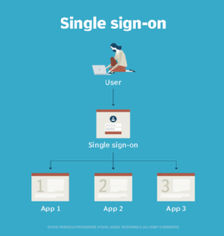
Comparing Authentication Services
Some other available authentication services ensure that credentials are not sent in cleartext (must use encrypted credentials).
Single Sign-On
refers to a user’s ability to log on once and access multiple systems without logging on again.
Can be used both by employees and customers
increases security because the user only needs to remember one set of credentials
also much more convenient for users to access network resources if they only have to log on one time
There is debate that SSO adds in risks because, if compromised it provides the attacker access to multiple systems.
Benefits of Single Sign-On:
Stronger security
Enhanced customer experience
Reduces costs and password resets
Improved employee productivity
Dr. M Malook Rind Information Security Lecture 8

Slide 28
Comparing Authentication Services
SSO and a Federation
Federated Identity Management System also known as federated SSO, provides central authentication in a non-homogeneous environment
a user can authenticate to one domain and then access resources in the other domain without having to perform a separate login process
FIM is achieved through the use of standard protocols like SAML, OAuth, OpenID Connect and SCIM. These open standards enable the secure transmission of authentication and access information across domains
Security Assertion Markup Language (SAML) is an Extensible Markup Language (XML)–based data format used for SSO on web browsers.
Many web-based portals use SAML for SSO.
Dr. M Malook Rind Information Security Lecture 8

Slide 29
What is Access Control?
Access control refers to the mechanisms that work together to protect organizational assets while simultaneously allowing controlled access to authorized subjects.
Access control is applicable at all levels of an organization and covers all types of assets.
Access control enables management to:
Specify which users can access the system
Specify what resources they can access
Specify what operations they can perform
Provide individual accountability—know who is doing what
Dr. M Malook Rind Information Security Lecture 8

Slide 30
Access control principles and applicability
Fundamental access control principles include
Access control includes all aspects and levels of an organization and covers all types of assets, including:
Facilities
Systems/Devices
Information
Personnel
Applications
Need to Know | Least Privilege | Separation of Duties
Defending sensitive assets by restricting access to only required personnel who require access | Defending sensitive assets by granting only the minimum permissions required by the user or system | Defending sensitive assets by requiring more than one person to complete a task, to prevent errors and fraud.
Dr. M Malook Rind Information Security Lecture 8

Slide 31
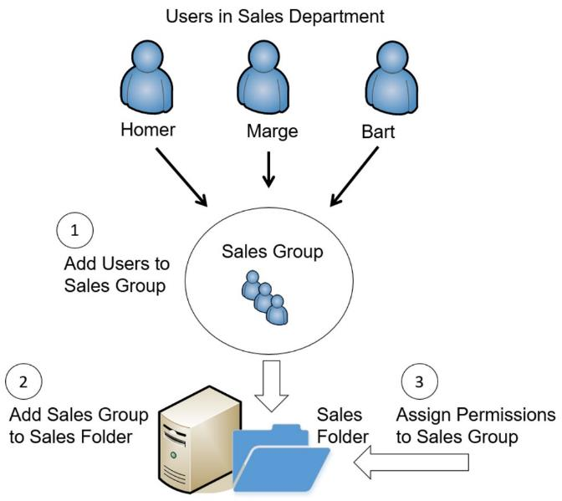
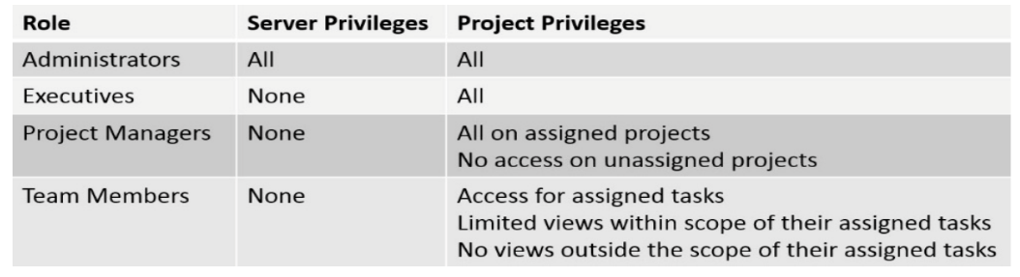
Comparing Access Control Models
Access control determines who has access to which resources through previously placed authentication and authorization rules.
Access control is the best way to make sure only the people you trust can access sensitive areas of your property.
Access controls authenticate users by verifying login credentials.
access control schemes makes it easier to apply access policies to users within a network
The access control schemes (sometimes referred to as access control models) are:
Role-Based Access Control (role-BAC)
Uses roles (often implemented as groups) to manage rights and permissions for users.
Grant access by placing users into roles based on their assigned jobs, functions, or tasks
administrator creates the roles and then assigns specific rights and permissions to the roles
Often use a matrix
Dr. M Malook Rind Information Security Lecture 8

Slide 32
Comparing Access Control Models
Rule-Based Access Control
Based on a set of approved instructions, such as an access control list.
Routers and firewalls use rules within access control lists (ACLs).
These rules define the traffic that the devices allow into the network.
administrators create the rules, and the rules stay the same unless an administrator changes them again.
If your business closes at 5 p.m., there’s no need for anyone to have access to your main office, even managers, after closing.
With rule-based access control, you can set a rule to deny access to everyone from 5 p.m. to 9 a.m. the next morning.
Discretionary Access Control
Specifies the owner establishes access for the objects. Many operating systems, such as Windows and most Unix-based systems, use the DAC scheme
Files, folders, shares
Owner has full, explicit control of the object
administrators to restrict access to files and folders with permissions.
File system Permissions: Write, Read, Read & execute, Modify, Full control
Dr. M Malook Rind Information Security Lecture 8

Slide 33
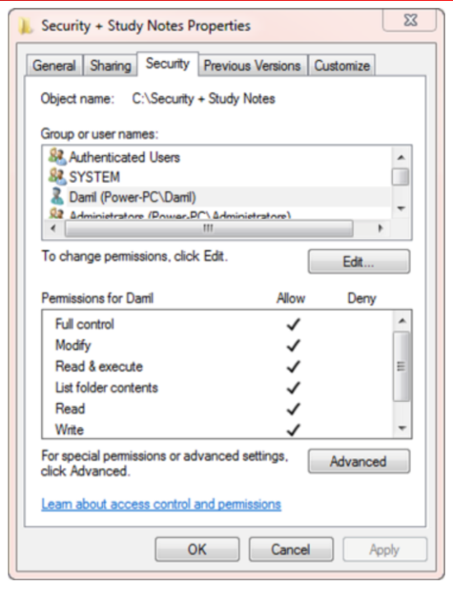
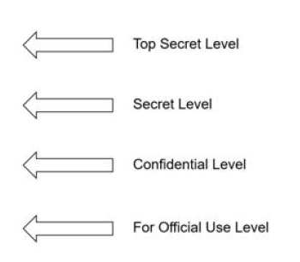
Comparing Access Control Models
Mandatory Access Control
Assign labels to both subjects (users) and objects (files or folders).
When the labels match, the system can grant a subject access to an object. When the labels don’t match, the access scheme blocks access.
SELinux (Security-Enhanced Linux)
Uses MAC model
Helps prevent malicious or suspicious code
from executing
Dr. M Malook Rind Information Security Lecture 8

Slide 34
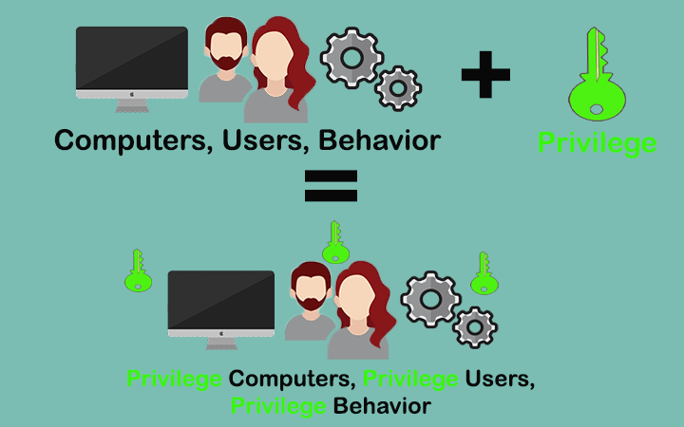

Comparing Access Control Models -
Conditional Access
can be used with traditional access control schemes but adds additional capabilities to enforce organizational policies, using if-then statements
administrators create a Conditional Access policy that requires users to log on with multifactor authentication (MFA) to access them.
Conditional Access policies may include
User or group membership
IP location
Device
Dr. M Malook Rind Information Security Lecture 8

Slide 35
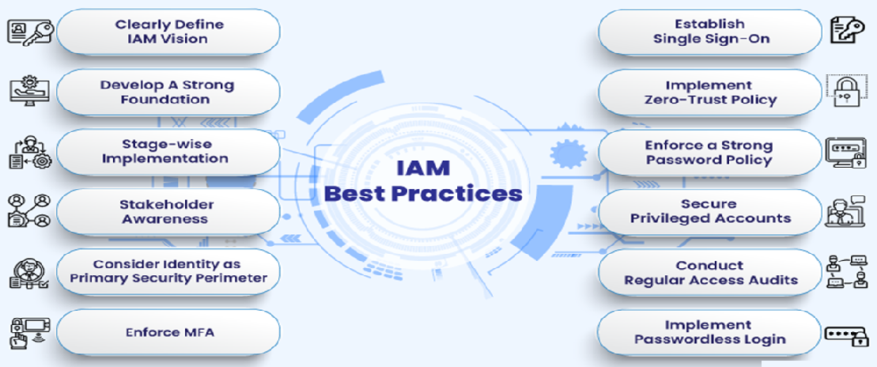
Implementing IAM
Dr. M Malook Rind Information Security Lecture 8

Slide 36
Thanks
Dr. M Malook Rind Information Security Lecture 8

